Slide 1


Slide 2
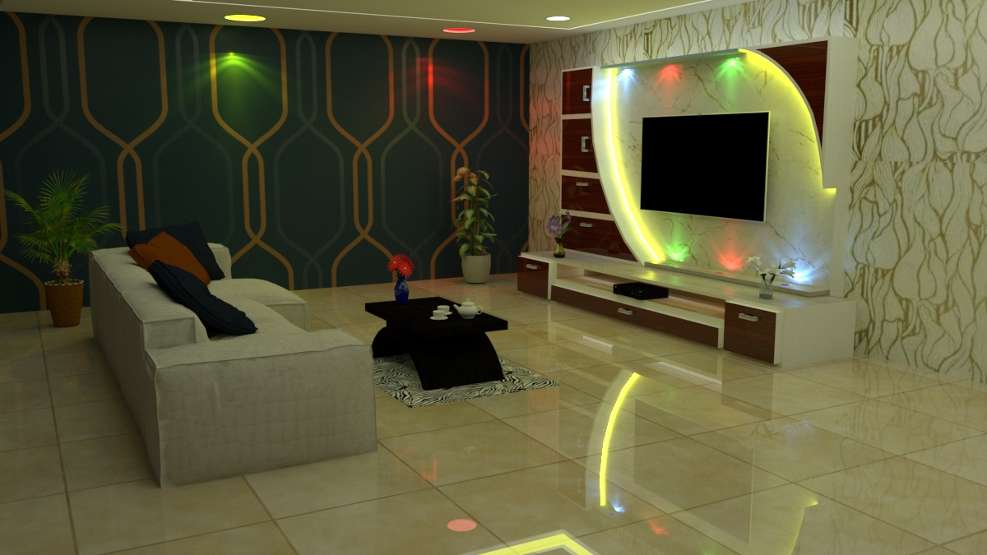
1 HALL INTERIOR DESIGN (SKETCHUP, V-RAY)

Slide 3

2 CEALING DESIGN (SKETCHUP, V-RAY)

Slide 4
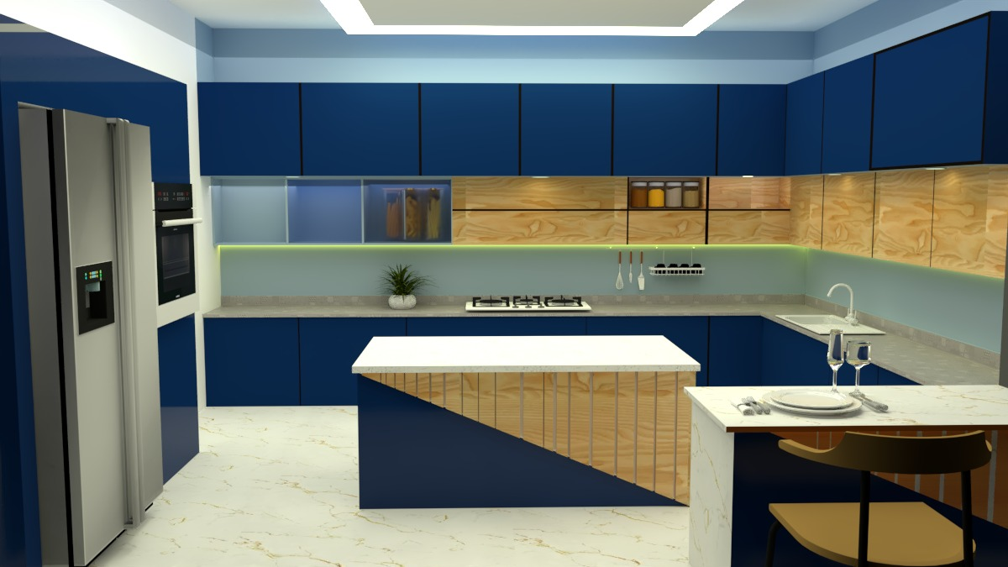
3 KITCHEN DESIGN (SKETCHUP, V-RAY)

Slide 5
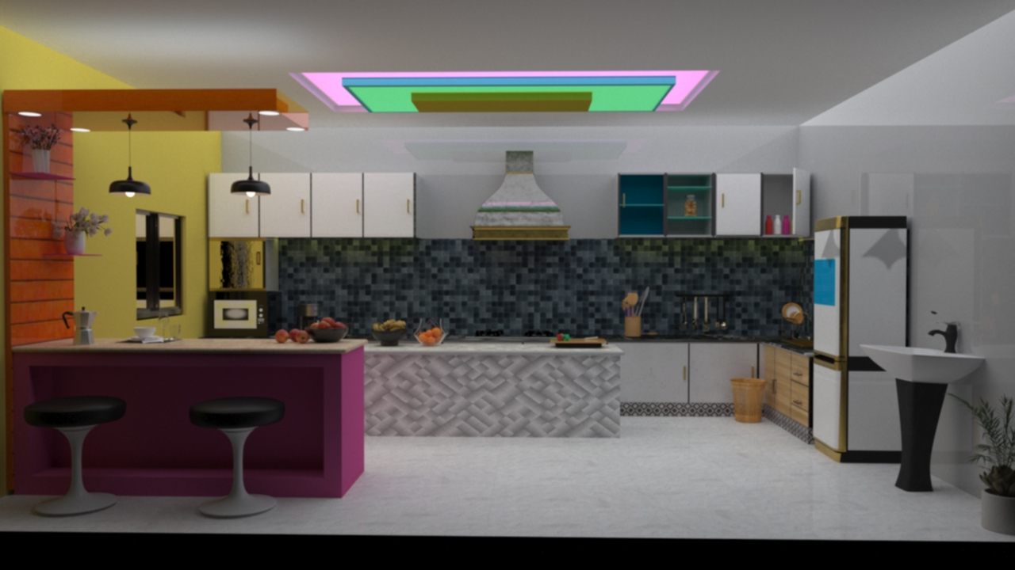
4 KITCHEN INTERIOR DESIGN [3DS MAX, V-RAY]

Slide 6
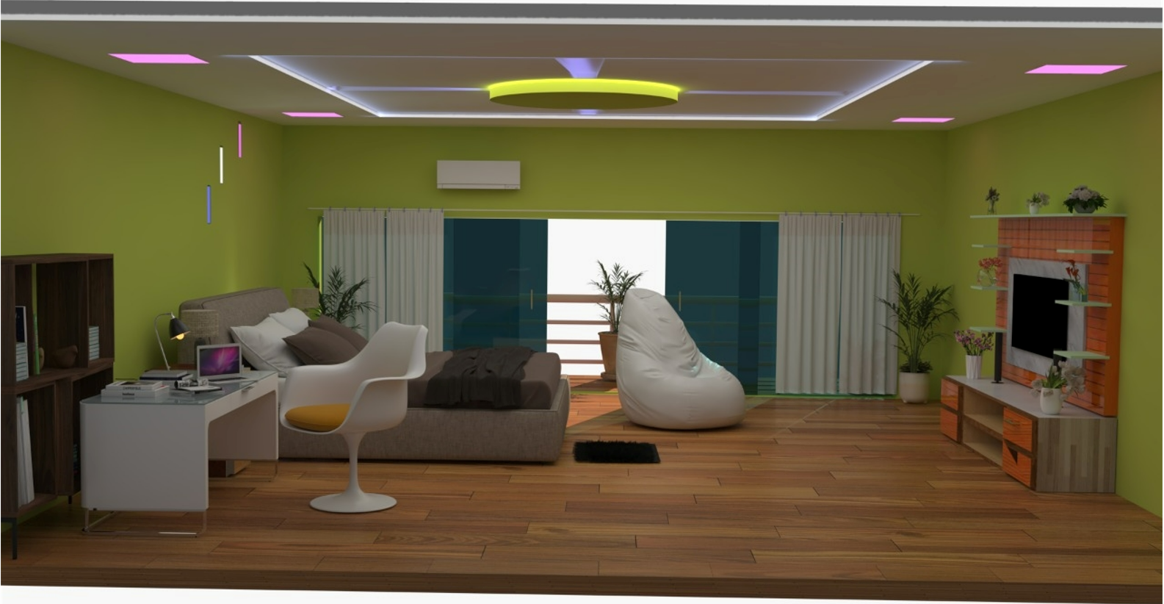
5 BED ROOM INTERIOR DESIGN [3DS MAX, V-RAY]

Slide 7
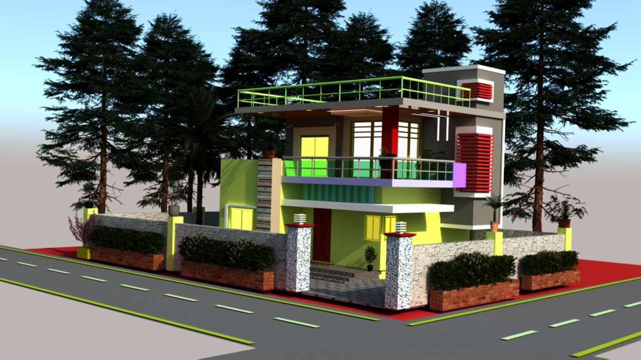
6 HOME EXTERIOR DESIGN [3DS MAX, V-RAY]

